Slide 1
The Antibodies Against COVID-19
Presented By
Nancy Alexandre
Bethel Technology School
10/27/2022

Slide 2
AGENDA
My Background
What is COVID-19
The Virus That Causes COVID-19
The Main Purpose of This Project
Methods
Data Survey Questions
Findings
Summary
Conclusion
References
Acknowledgement
Questions?

Slide 3
My Background
Education
B.A. in Chemistry
MBA
Worked in the Pharmaceutical Industry for several years
QA/QC Data Reviewer
Currently working as a Data Reviewer for a Pharma/Cosmetics Company

Slide 4
What is COVID-19
COVID-19 (coronavirus disease 2019) is a disease caused by a virus named SARS-CoV-2 and was discovered in December 2019 in Wuhan, China. It is very contagious and has quickly spread around the world. COVID-19 most often causes respiratory symptoms that can feel much like a cold, a flu, or pneumonia.
COVID-19 may attack more than your lungs and respiratory system. Other parts of your body may also be affected by the disease.

Slide 5
What is COVID-19
Most people with COVID-19 have mild symptoms, but some people become severely ill.
Some people including those with minor or no symptoms may suffer from post-COVID conditions — or “long COVID”.
Older adults and people who have certain underlying medical conditions are at increased risk of severe illness from COVID-19.
Hundreds of thousands of people have died from COVID-19 in the United States.

Slide 6
SARS-CoV-2, the virus that causes COVID-19
COVID-19 is caused by a virus called SARS-CoV-2. It is part of the coronavirus family, which include common viruses that cause a variety of diseases from head or chest colds to more severe (but more rare) diseases like severe acute respiratory syndrome (SARS) and Middle East respiratory syndrome (MERS).
Like many other respiratory viruses, coronaviruses spread quickly through droplets that you project out of your mouth or nose when you breathe, cough, sneeze, or speak.

Slide 7
The Main Purpose of This Project
To better understand the percentage of people in the United States who have antibodies against SARS-CoV-2 (the virus that causes COVID-19) and to track how this percentage changes over time.
This is the largest nationwide COVID-19 seroprevalence survey to date.

Slide 8



Methods
Tools
Jupyter Notebooks
RStudio
Tableau
Data Wrangling
CDC dataset on COVID-19 and rename to a new dataset
Rename the variables one by one in the new dataset
Drop floats and unwanted variables from the dataset
Export Data frame to a csv file
Convert floats to integers

Slide 9
Methods
Analyses
Pearson’s product –moment correlation
Dependent t-Test in Python
MANOVA
k-Means Clustering in Python
ANOVA in R Part II
Sample Size
1270

Slide 10
Data Survey Questions
Are the numbers of prevalence of antibodies similar between Asian and Hispanic?
Are the numbers of prevalence of antibodies similar between Black and White?
Are the numbers of prevalence of antibodies similar between Male and Female?
Are the numbers of prevalence of antibodies similar between the age of 16-29 years and 30-49 years?

Slide 11
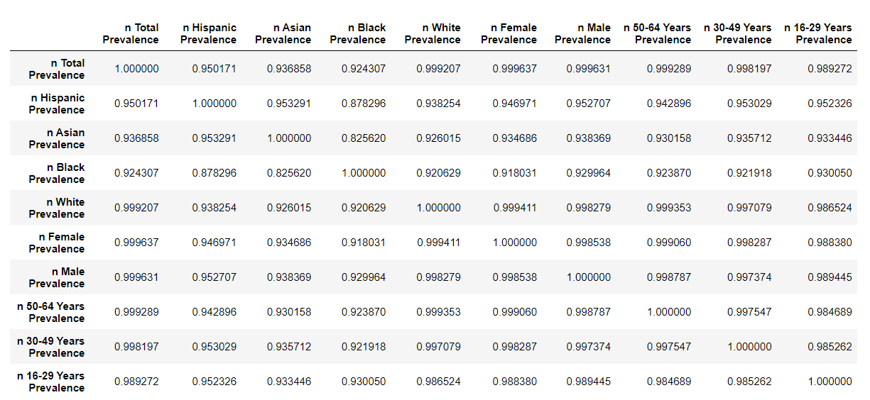
Correlation

Slide 12
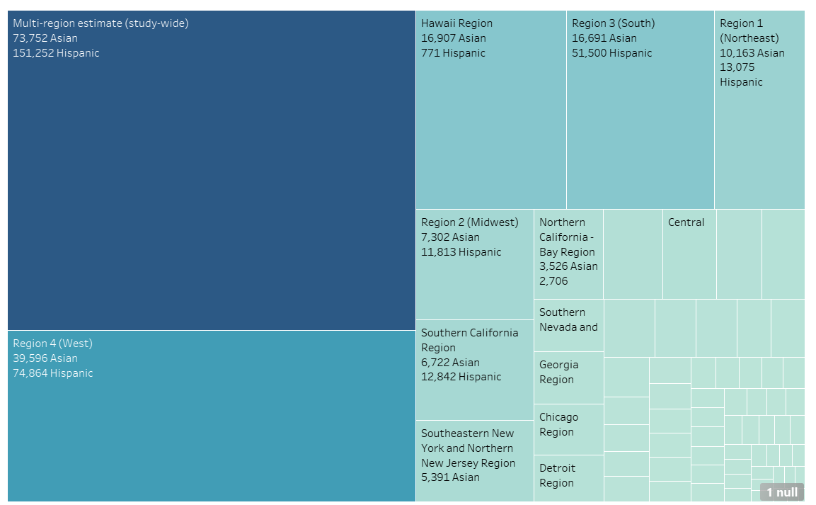
Data Survey Between Asian and Hispanic

Slide 13
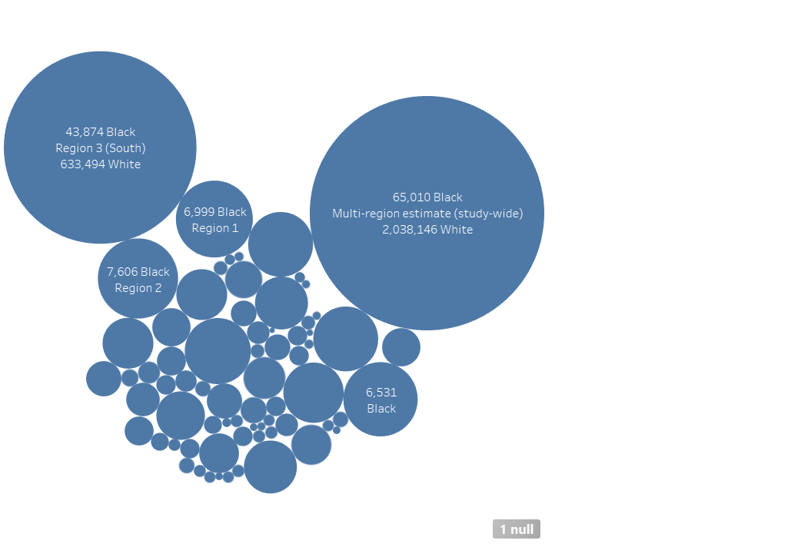
Data Survey Between Black and White

Slide 14
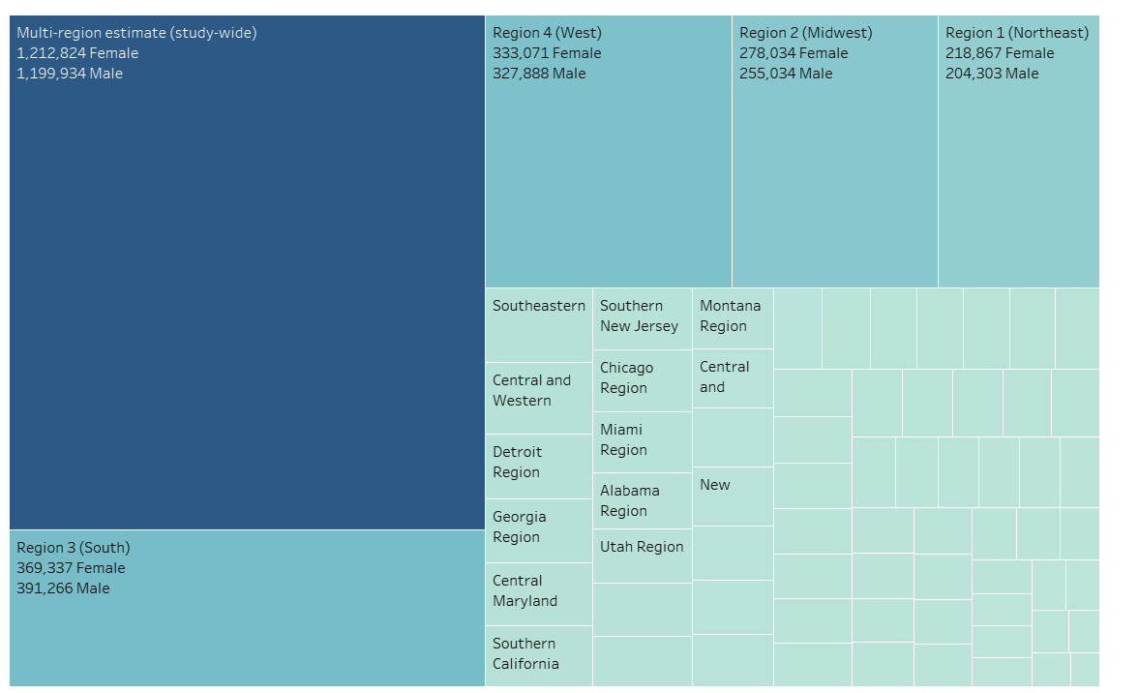
Data Survey Between Male and Female

Slide 15
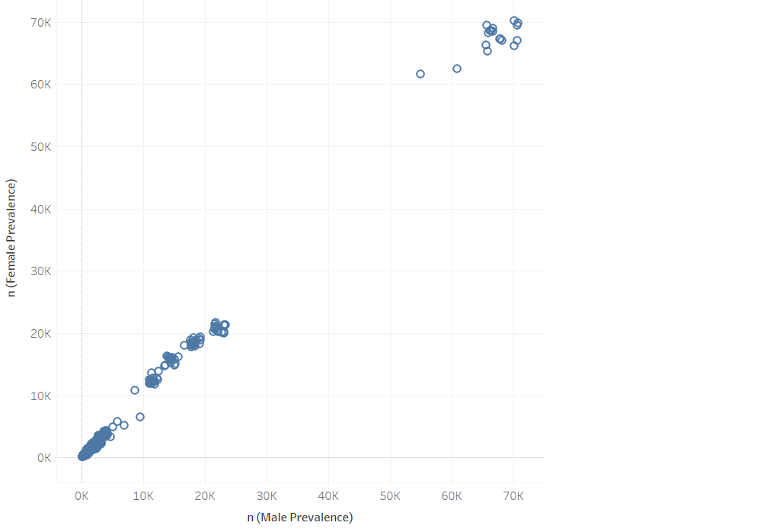
Data Survey Between Male and Female

Slide 16
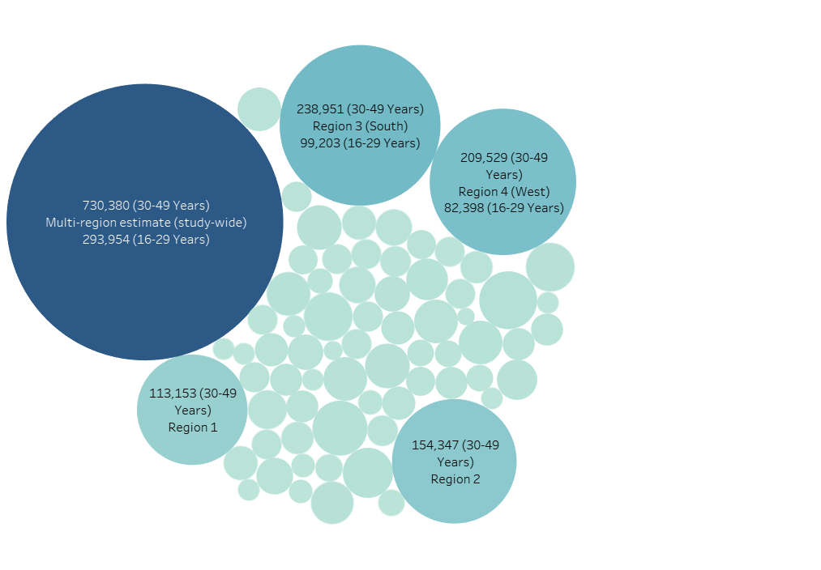
Data Survey Between 16-29 Years and 30-49 Years

Slide 17
Findings
Over time the percentage of Antibodies against COVID-19 will change.
The numbers in the survey are very correlated to each other.
There is a significant relationship between the dependent variables

Slide 18
Summary
The goal is to see how long it will take for the antibodies against COVID-19 to decrease for each participant.
To determine if the study will be accurate since the time period is between July 2020 through December 2021.
The correlation between each group was significant.
To see how the percentage for each group will change over time by looking at the mean cluster.

Slide 19
Conclusion
In Conclusion, the findings will help the U.S government and other countries to be more informed and more prepared for an outbreak.
It helps us to discover how the human body can strive and adapt to viruses. Also, it can be deadly.
COVID-19 showed the world how fragile we are, and to learn how to collaborate, and share information with each other.
The impact of COVID-19 on the world economy was detrimental to all industries.
Also, for some companies their profit margin skyrocketed.

Slide 20
References
https://www.cdc.gov/coronavirus/2019-ncov/your-health/about-covid-19/basics-covid-19.html
Google.com

Slide 21
Acknowledgement
Jamie Reichenberger
Sarah Bahn
Phillip Doehle
Sarah Young
Michael Wilt
Victor Medel
Brandy Mendez
Bethel Tech Family

Slide 22
Questions?

